Slide 1


Slide 2
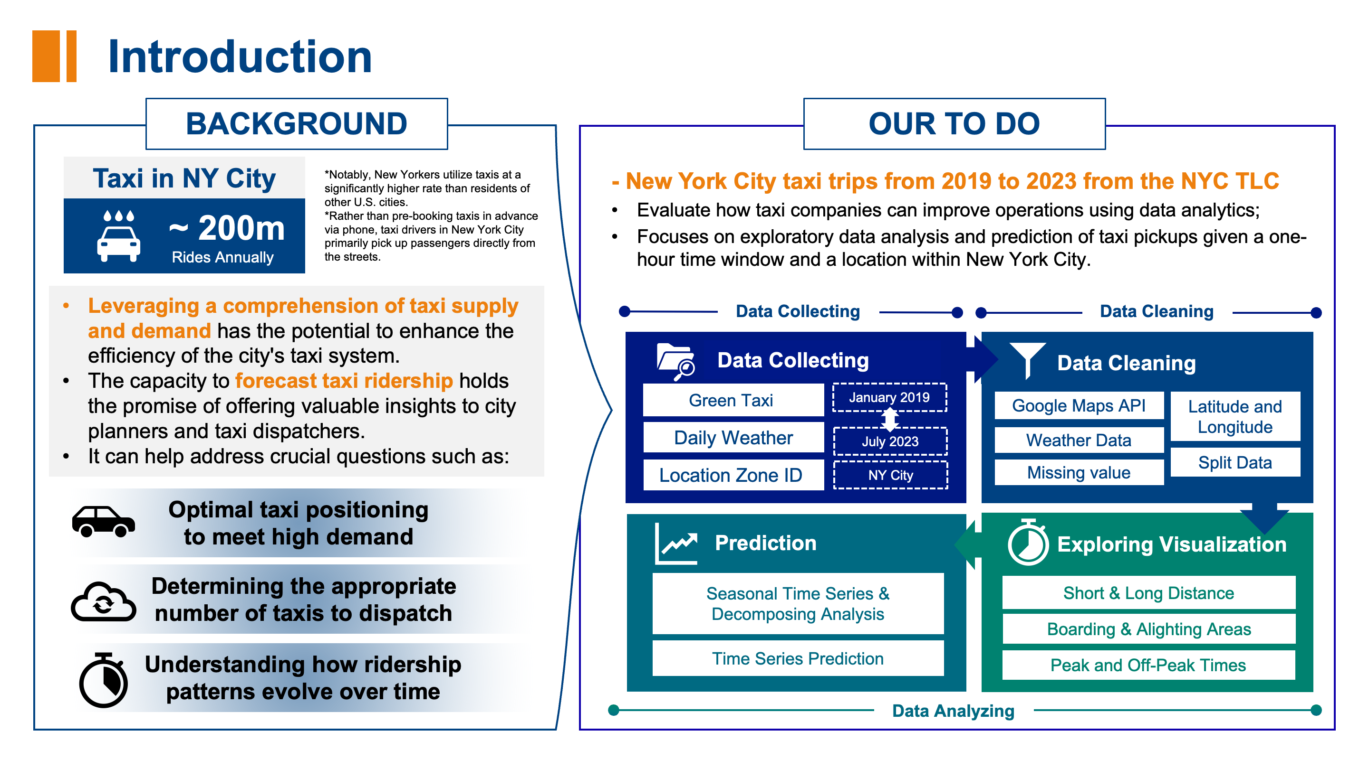
Regression

Slide 3
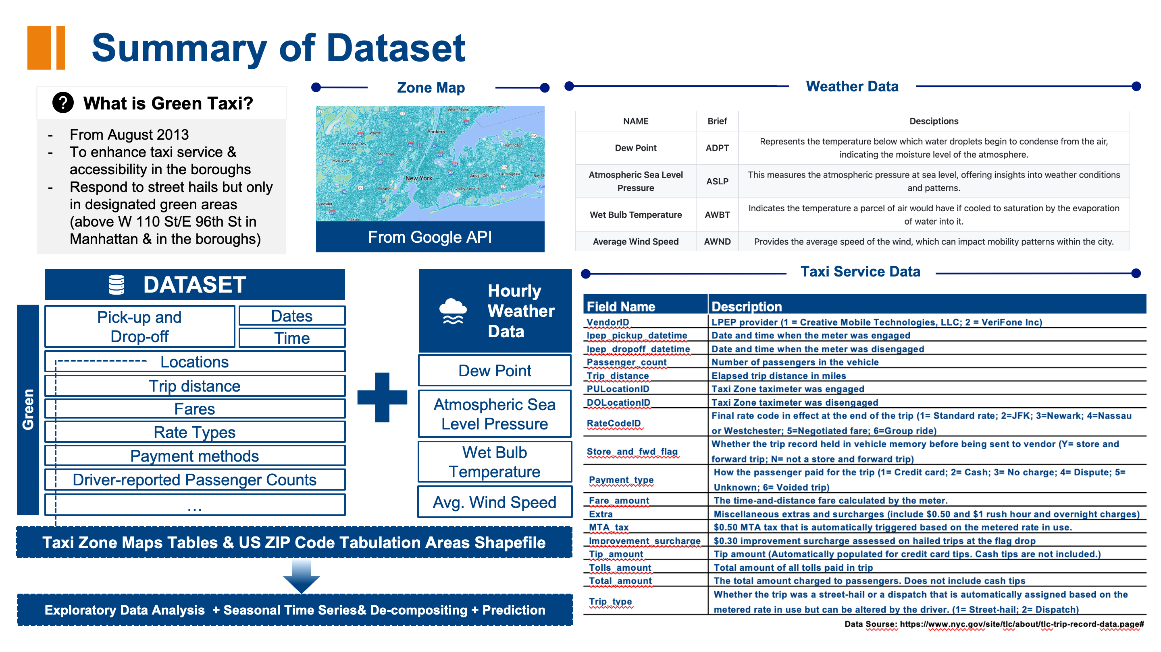
Regression

Slide 4
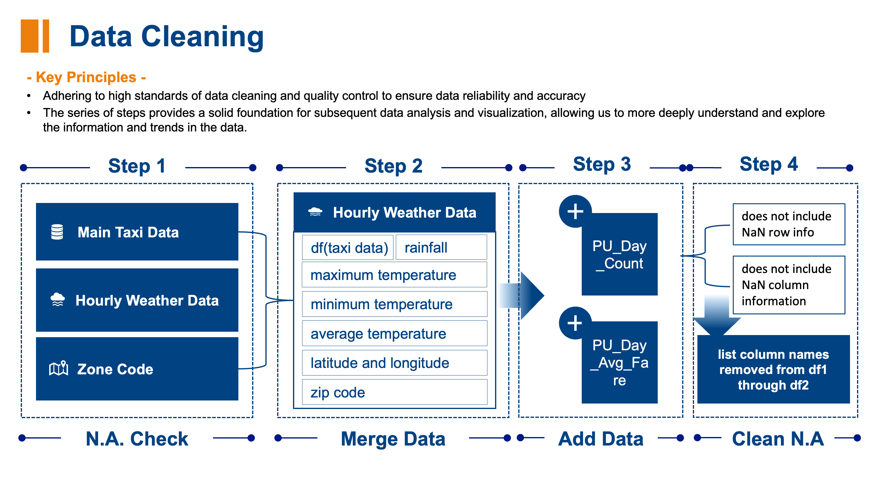

Slide 5
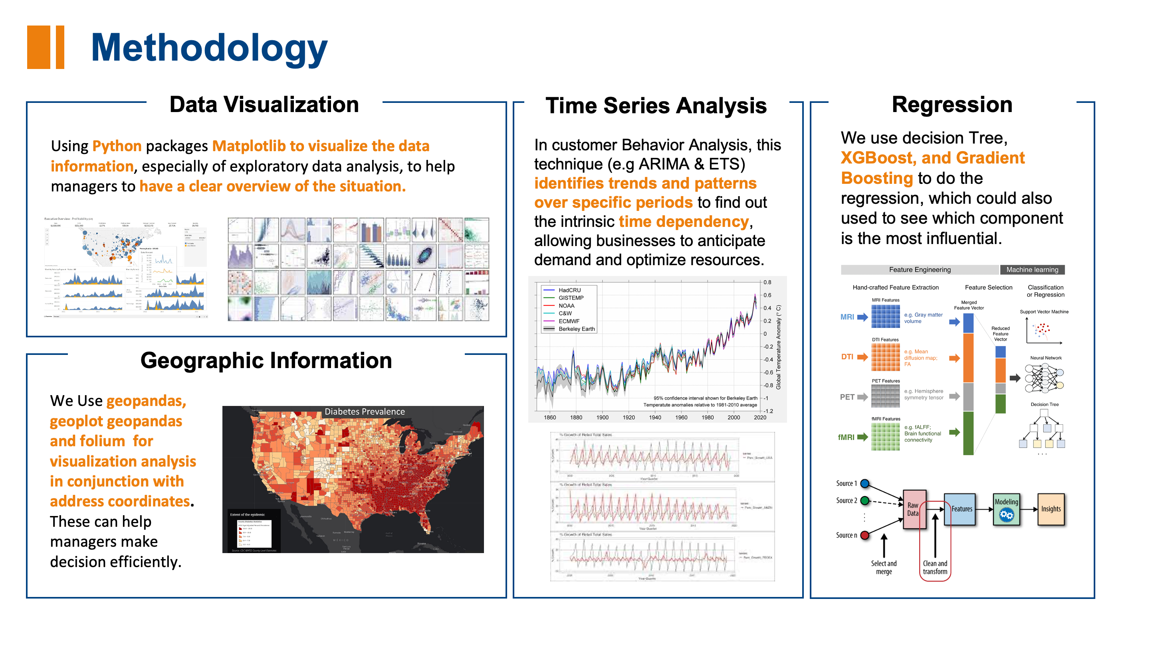

Slide 6
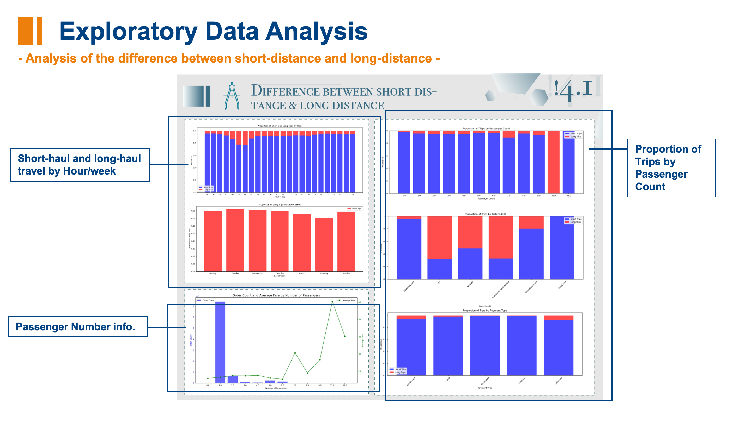
Time: 2019-01-01 to 2023-07-31

Slide 7
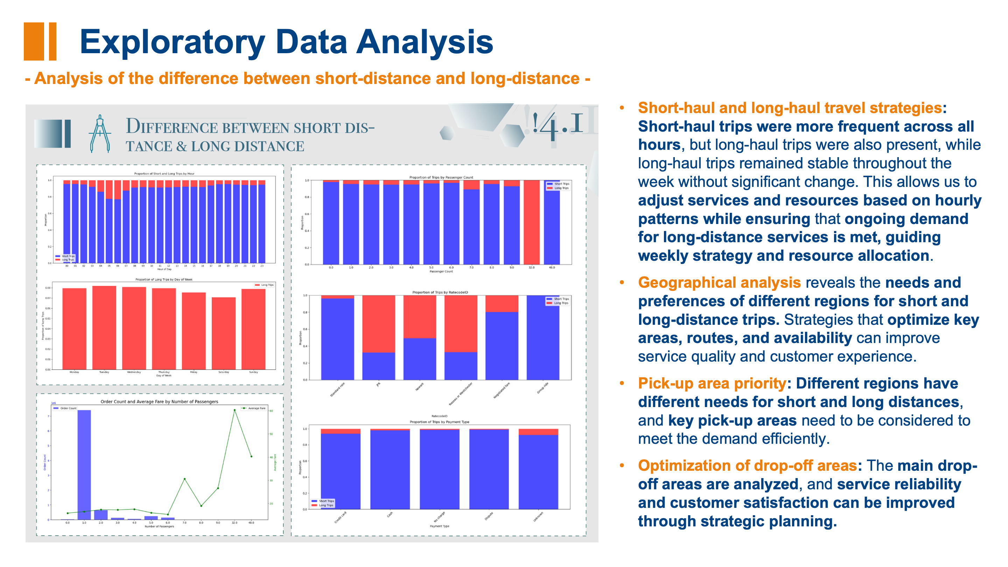

Slide 8
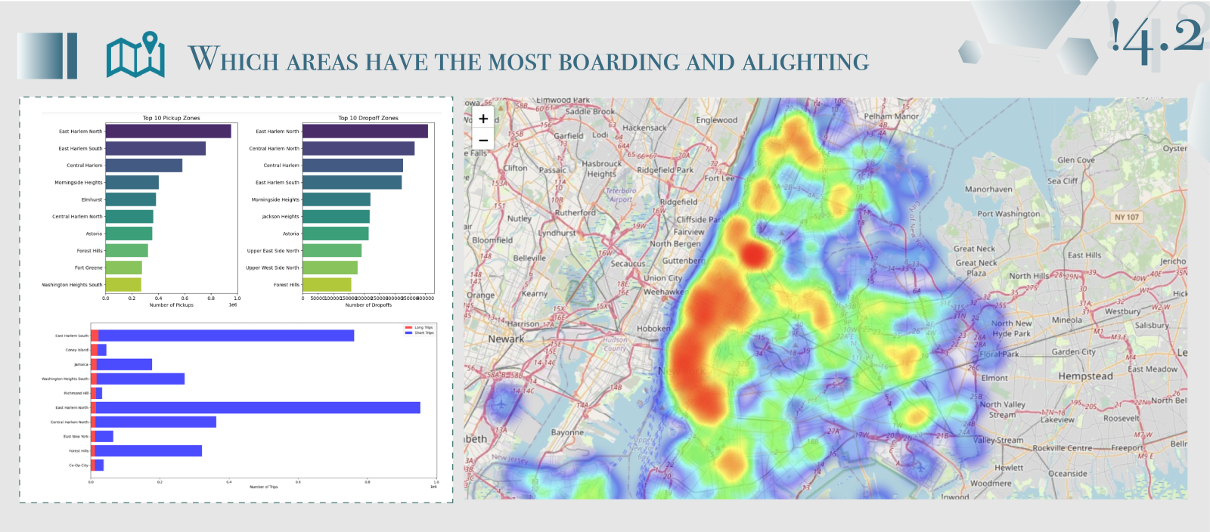
Exploratory Data Analysis
Which areas have the most boarding and alighting:
Top 10 Pickup Zones
Top 10 Dropoff
Zones
Top 10 Pickup
Zones for Long Trips
Heatmap for hailing counts in pickup area

Slide 9
Exploratory Data Analysis
Which areas have the most boarding and alighting:
East Harlem North is a critical transport hub for both pickups and dropoffs, implying a consistent demand for taxi services.
Areas like Central Harlem (both North and South) are significant for taxi services, indicating the need for a focused deployment of taxis in these neighborhoods.
The presence of Upper East and West Sides points to a high residential and possibly tourism-driven demand.
LaGuardia Airport's high dropoff volume highlights the taxi industry's reliance on airport traffic and indicates a potential for fixed-fare, scheduled rides for airport commuters.
Taxi operators are encouraged to leverage these insights for strategic decision-making: focusing on profitable areas with higher average fares and ensuring a robust presence in high-demand zones like Manhattan to maintain market presence.

Slide 10
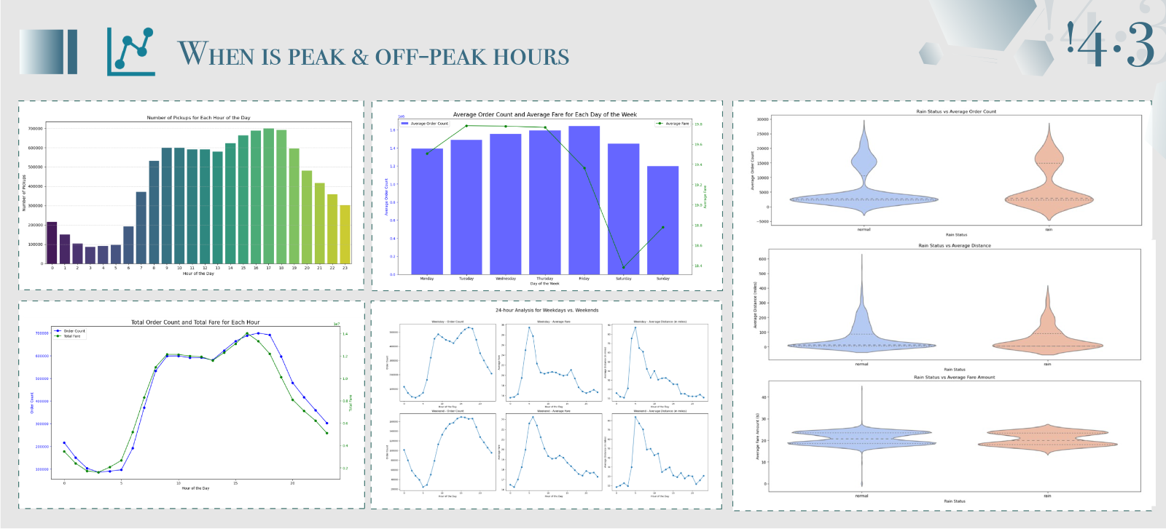
Exploratory Data Analysis
Peak and Off-Peak Times
Average Order Count and Average Fare for Each Day of the Week
Rain Status vs Average Order Count
# of Pickups for Each Hour of the Day
Rain Status vs Average Distance
Total Order Count and Total Fare for Each Hour
Rain Status vs Average Fare Amount
24-Hour Analysis for Weekdays & Weekends

Slide 11
Exploratory Data Analysis
Peak and Off-Peak Times
Hourly Trends: Evening rush hour, around 6 PM, sees peak taxi pickups; demand is lowest from midnight to 5 AM.
Daily Patterns: Taxi orders and fares are highest in the evening, indicating more activity and potentially longer rides.
Weekly Insights: Steady taxi demand on weekdays, with a dip on Fridays and lowest on Sundays; fares peak on Fridays.
Weekday/Weekend Comparison: Weekday demand peaks during commute times; weekends have a later start and extended evening demand.
Weather Influence: Rain increases taxi use, with higher ride frequency and distance leading to increased fares.
These insights could help taxi service providers in scheduling drivers, setting dynamic pricing, and understanding the influence of weather on taxi usage.

Slide 12
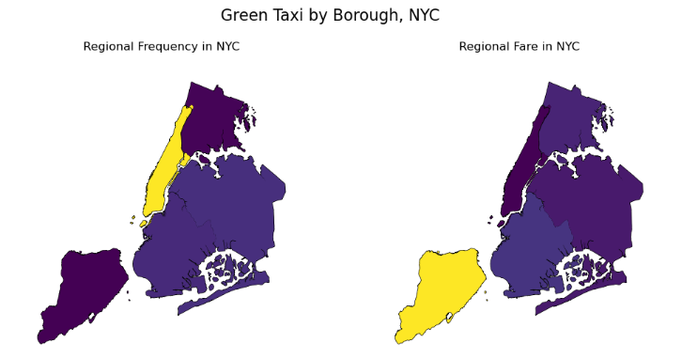


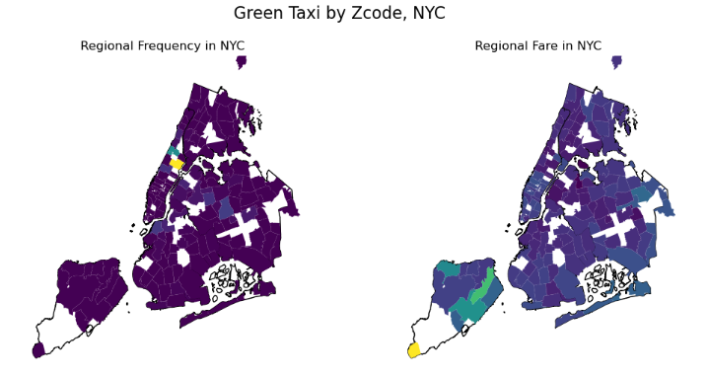

Geo-visualization
Area Analysis
Taxi Demand in Different Areas
Top & Lowest
Borough
Areas with the highest or lowest demand
Manhattan
&
The Bronx
Zcode
Fare Amounts in Different Areas
Top & Lowest
Staten Island
&
The Bronx
Borough
Areas with the highest or lowest fare
Zcode
Strategy
Dynamic pricing models in Manhattan to capitalize on high demand
Exploring service expansion or promotion in lower frequency areas like The Bronx

Slide 13
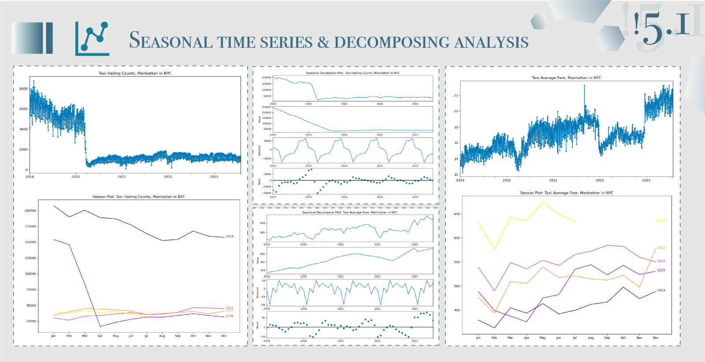
Time series
Time: 2023-01-01 to 2023-06-31
Methods: Seasonal time series analysis and Decomposing Analysis
Orders have fallen sharply
Prices have risen sharply
This will help taxi companies maintain profitability in the face of declining order volumes and increase average revenue per order, thus meeting challenges during the pandemic. Companies can use this insight to adapt their operational strategies to market changes and take steps to improve efficiency.

Slide 14
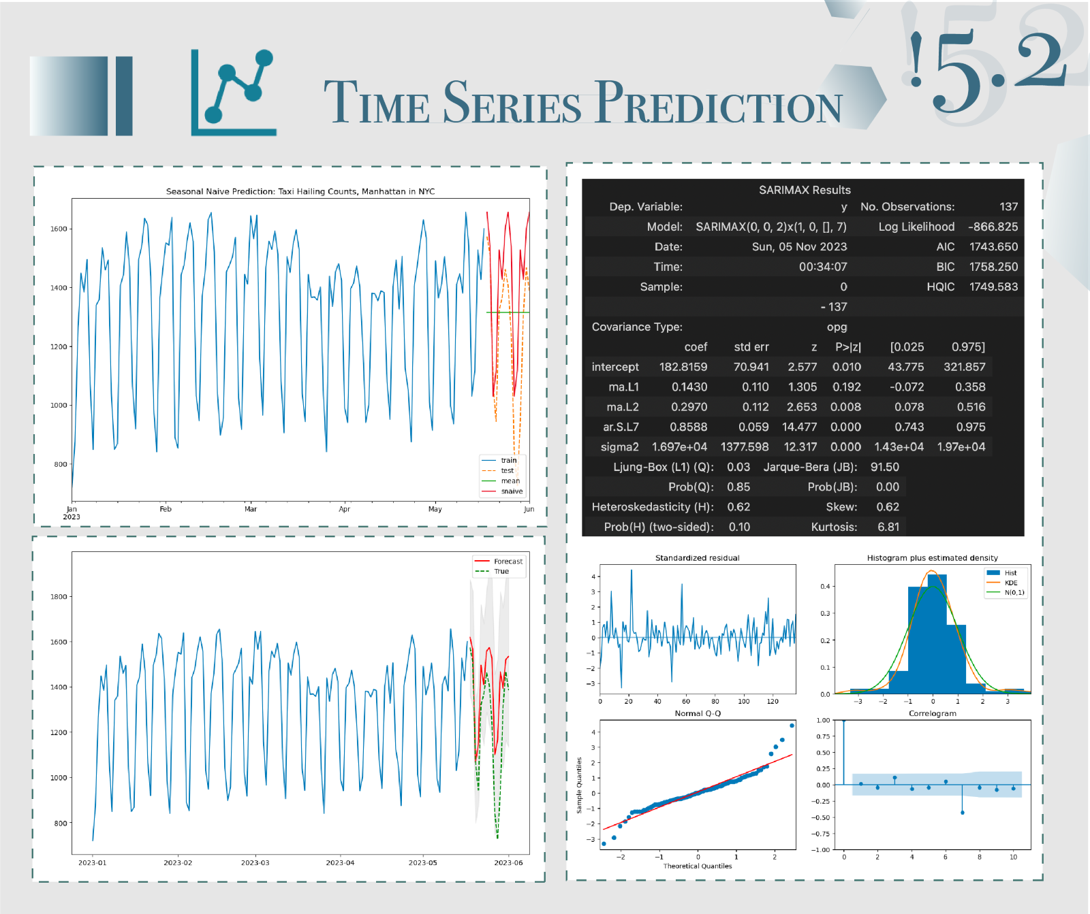
Time series
Time: 2023-01-01 to 2023-06-31 and last 10%
Time Series Prediction: Seasonal Naive Prediction & ARIMA
By leveraging the predictive power of the ARIMA model, companies can anticipate shifts in taxi demand with greater accuracy, allowing them to adjust fleet deployment and pricing strategies proactively to sustain profitability even as order volumes may vary. Utilizing these data-driven insights, taxi services can adeptly modify their operational tactics in response to market dynamics, ensuring they are positioned to enhance efficiency and maintain service excellence despite the challenges presented by a rapidly changing environment.
Seasonal Naïve Prediction: Taxi Hailing Counts, Manhattan in NYC
ARIMA Model Summary
ARIMA: Taxi Hailing Counts, Manhattan in NYC
ARIMA Model
Diagnostics Plot

Slide 15
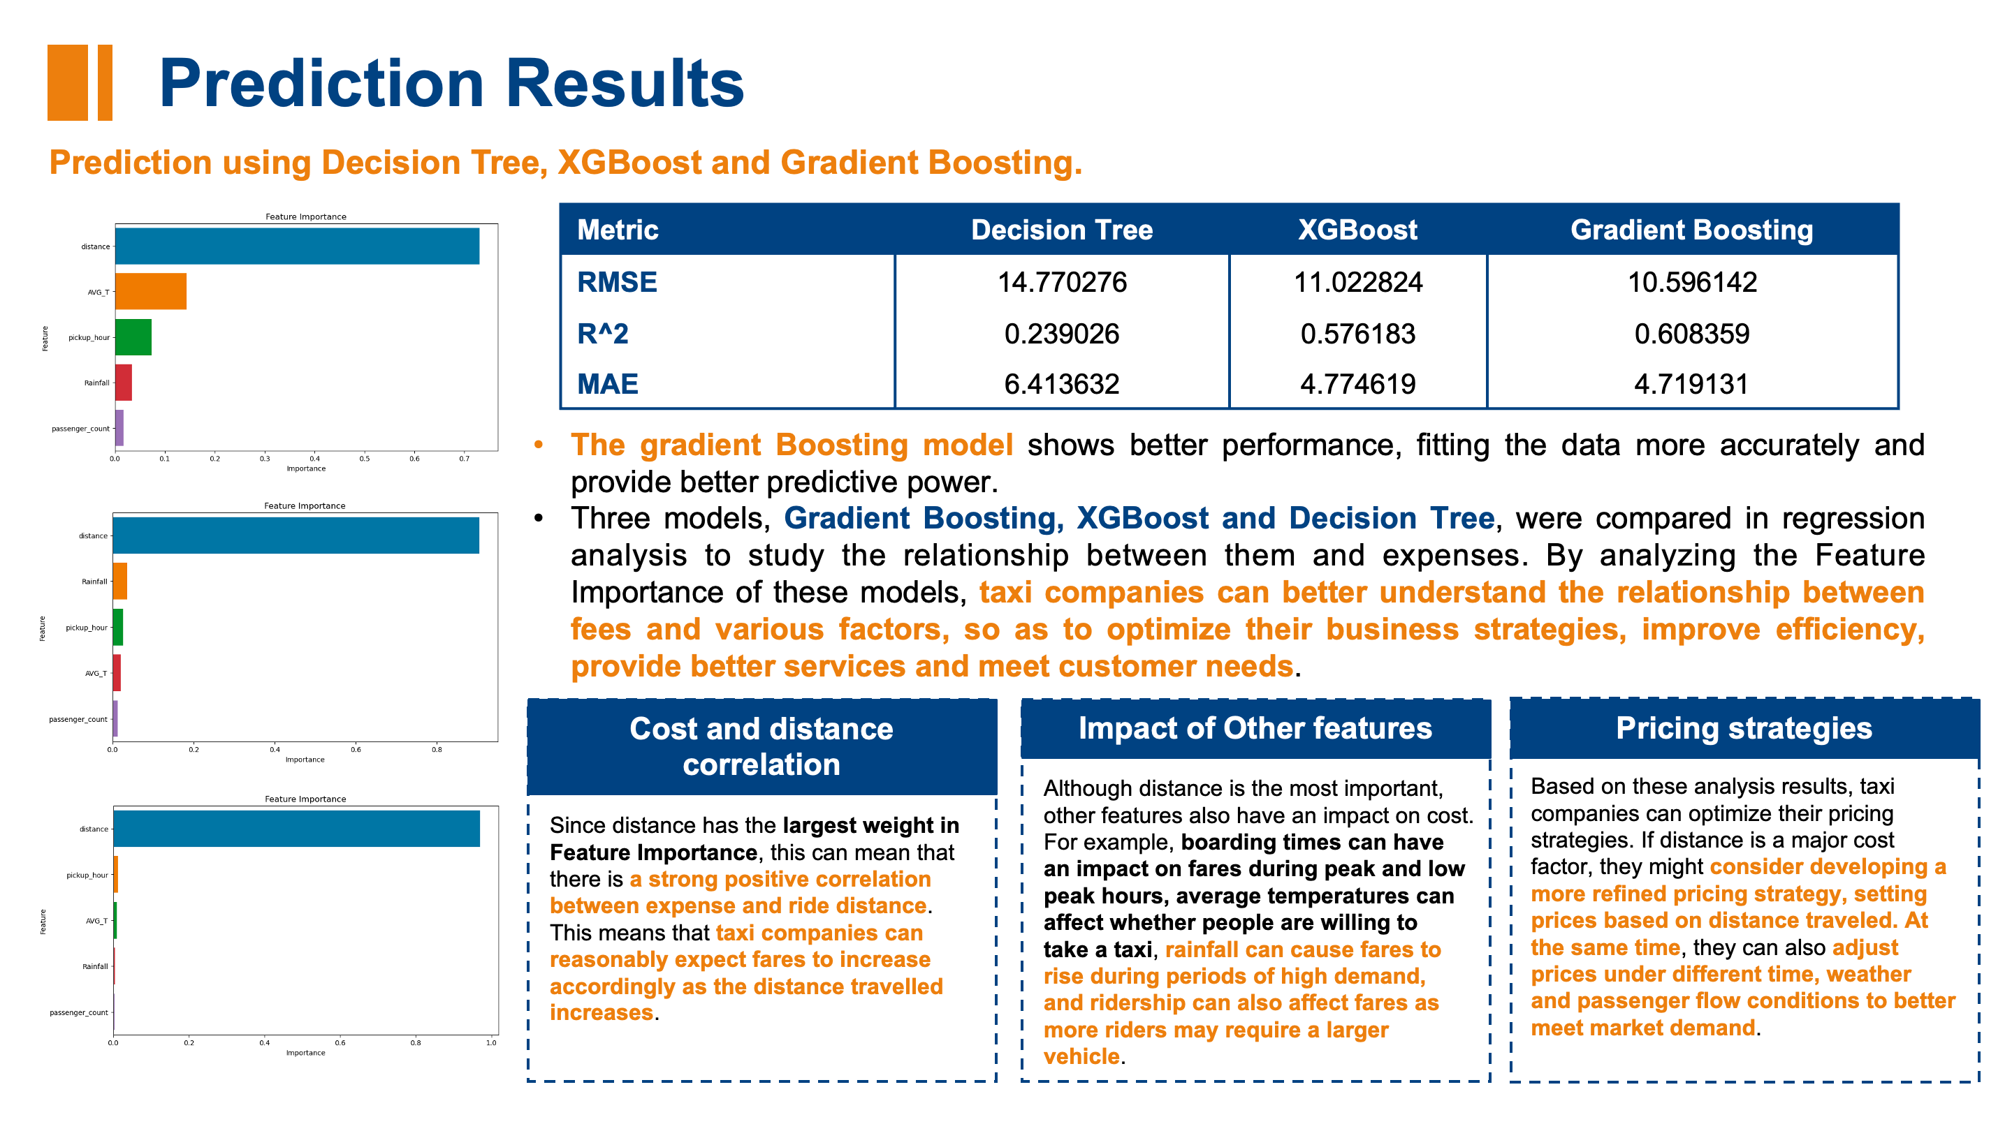
Time: 2022-08-31 to 2023-07-31

Slide 16


